Slide 1
DEPARTMENT OF CSE
COURSE NAME – ADAPTIVE Software Engineering
COURSE CODE – 22CS2119R
Topic:
TEST STRATEGIES FOR CONVENTIONAL SOFTWARE

Slide 2
AIM OF THE SESSION
To familiarize students with the basic concept of System Testing
INSTRUCTIONAL OBJECTIVES
This Session is designed to:
What is the process of system testing
Types of system testing
Tools used for system testing
Advantages and disadvantages of system testing
LEARNING OUTCOMES
At the end of this session, you should be able to:
Define system testing
2. Importance of system testing in software development

Slide 3
AGENDA
Introduction to system testing
What is system testing
What are the types of system testing
Which tools are used for system testing
Process of system testing
Advantages and disadvantages of system testing

Slide 4
Introduction of system testing
System testing is a type of software testing that evaluates the overall functionality and performance of a complete and fully integrated software solution. It tests if the system meets the specified requirements and if it is suitable for delivery to the end-users. This type of testing is performed after the integration testing and before the acceptance testing.

Slide 5
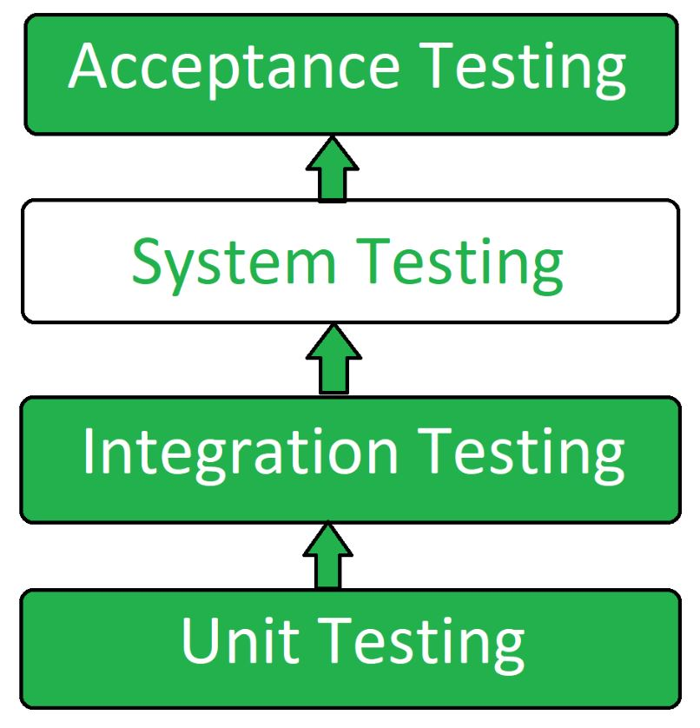
System testing

Slide 6
What is system testing
System Testing is a type of testing that is performed on a complete integrated system to evaluate the compliance of the system with the corresponding requirements.
System Testing is carried out on the whole system in the context of either system requirement specifications or functional requirement specifications or in the context of both.

Slide 7
Types of system testing
Performance Testing
Load Testing
Stress Testing
Scalability Testing

Slide 8
Types of system testing
Performance Testing: Performance Testing is a type of software testing that is carried out to test the speed, scalability, stability and reliability of the software product or application.
Load Testing: Load Testing is a type of software Testing which is carried out to determine the behavior of a system or software product under extreme load.

Slide 9
Types of system testing
Stress Testing: Stress Testing is a type of software testing performed to check the robustness of the system under the varying loads.
Scalability Testing: Scalability Testing is a type of software testing which is carried out to check the performance of a software application or system in terms of its capability to scale up or scale down the number of user request load.

Slide 10
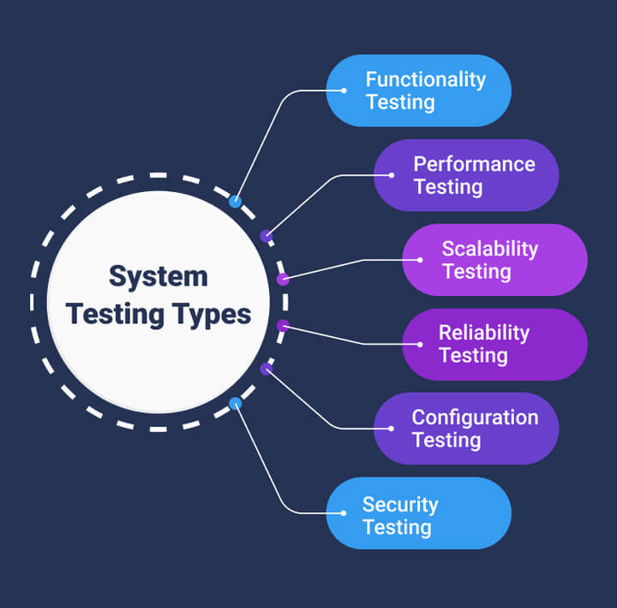
Types of system testing

Slide 11
Tools for system testing
HP Quality Center/ALM
IBM Rational Quality Manager
Microsoft Test Manager
Selenium
Appium
Load Runner
JMeter
Apache JServ
SoapUI
The choice of tool depends on various factors like the technology used, the size of the project, the budget, and the testing requirements.

Slide 12
process of system testing
Test Environment Setup
Create Test Case
Create Test Data
Execute Test Case
Defect Reporting
Regression Testing
Log Defects
Retest

Slide 13
process of system testing
Test Environment Setup: Create testing environment for the better quality testing.
Create Test Case: Generate test case for the testing process.
Create Test Data: Generate the data that is to be tested.
Execute Test Case: After the generation of the test case and the test data, test cases are executed.
Defect Reporting: Defects in the system are detected.
Regression Testing: It is carried out to test the side effects of the testing process.
Log Defects: Defects are fixed in this step.
Retest: If the test is not successful then again test is performed.

Slide 14
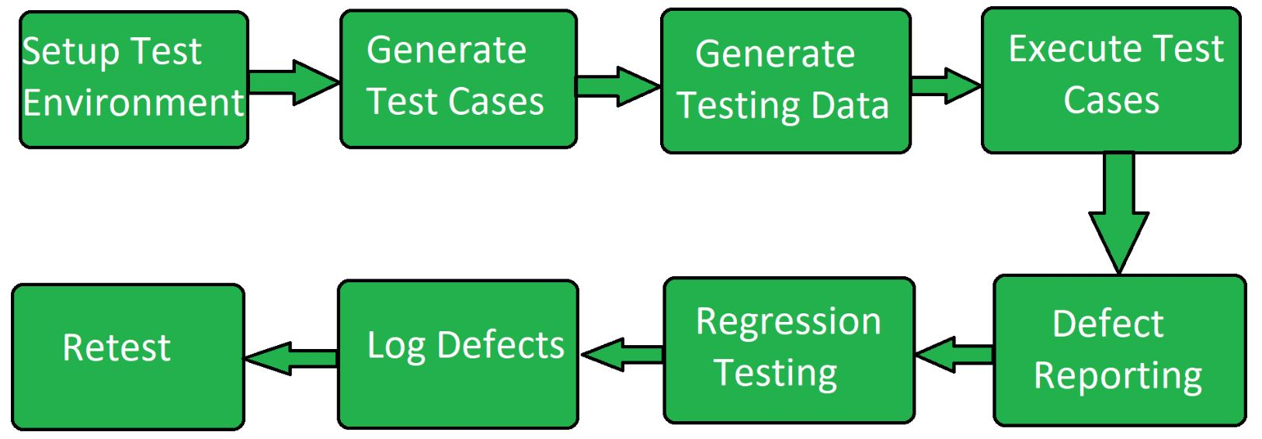
process of system testing

Slide 15
advantages of system testing
1. The testers do not require more knowledge of programming to carry out this testing. 2.It will test the entire product or software so that we will easily detect the errors or defects which cannot be identified during the unit testing and integration testing.
3.The testing environment is similar to that of the real time production or business environment.
4.It checks the entire functionality of the system with different test scripts and also it covers the technical and business requirements of clients.
5.After this testing, the product will almost cover all the possible bugs or errors and hence the development team will confidently go ahead with acceptance testing.

Slide 16
disadvantages of system testing
1.This testing is time consuming process than another testing techniques since it checks the entire product or software.
2.The cost for the testing will be high since it covers the testing of entire software.
3.It needs good debugging tool otherwise the hidden errors will not be found.

Slide 17
SELF-ASSESSMENT QUESTIONS
Define system testing.
What is the importance of system testing .

Slide 18
REFERENCES FOR FURTHER LEARNING OF THE SESSION
TEXTBOOKS:
1. Roger S.Pressman, “Software Engineering – A Practitioner’s Approach” 7th Edition, Mc Graw Hill,(2014).
2. Ian Sommerville, “Software Engineering”, Tenth Edition, Pearson Education, (2015).
3. Agile Software Development Ecosystems, Jim Highsmith, Addison Wesley; ISBN: 0201760436; 1st edition
Reference Book
Agile Modelling: Effective Practices for Extreme Programming and the Unified Process Scott Amber John Wiley & Sons; ISBN: 0471202827; 1st edition.
WEB REFERNCES/MOOCS:
https://www.digite.com/kanban/what-is-kanban/
http://www.scaledagileframework.com
https://www.guru99.com/test-driven-development.html
https://junit.org/junit5/

Slide 19

THANK YOU
Team – ADAPTIVE SOFTWARE ENGINEERING

